Slide 1
Self-management in Neighborhoods
101: Welcome and Introduction

Slide 2
Agenda
Goals
Urbánika’s Why
Stages and duration
Course’s structure
Basic rules
Work environment
Questions?
Let’s go!

Slide 3
Goals
Hello! This course is designed so that people living in the same common area...
1. Learn to identify and solve common problems through conviviality, peer-to-peer governance, and conflict resolution,
2. Know and implement regenerative or sustainable technologies in their neighborhoods, and that from these generate work and income that go to a budget of common benefit,
3. Know and integrate self-management technologies for budget management, access, and decision making without censorship or control by a few.

Slide 4
Urbánika’s
big why
Self-management: the recognition of our ability to make decisions and the principle of no one above me, no one below me.
Smart and decentralized: use of open, non-censorable, and non-permissioned technology.
Triple Impact: Economy, Planet, and Society.
Every urban commoning initiative should be designed like a human-based ecosystemic service which generates income to sustain its ongoing work, while forming positive cycles for the whole (nature and humanity).
Facilitating the emergence of self-managed, smart, regenerative cities

Slide 5
Duration and stages 1/2
🏗️ Facilitation. Neighbors will be guided through the entire process in which they will identify common problems, prioritize the most important problem to be solved, and co-create a solution always looking for the how yes.
Neighbors will also learn how to use sustainable and self-management technologies.
At the end of this stage, they will have graduated 🥳.
Duration: 11 sessions, 2 per week = 6 weeks.

Slide 6
Duration and stages 2/2
💪🏽 Reinforcement. Now that the neighbors know the process, it is their turn to repeat it with the next priority problem for them. Urbánika will be available when they need help, but now it is their turn to lead the process.
Duration: 1 session per week x 6 weeks.
🤝🏼Support among peers. Since the neighbors have been through the process twice, they will have access to a growing network of other graduates with whom to share experiences and resources. In addition, they will get free or discounted access to courses, conferences, films, books, and other events to enrich their knowledge about urban commoning.
Duration: As long as the neighbor’s membership is active.

Slide 7
Course structure
0. Introduction to the course and virtual environment setup
1. Peer-to-peer governance, part 1: Consent vs Consensus
2. Peer-to-peer governance, part 2: Debating points and not ideas
3. Peer-to-peer governance, part 3: Deliberating is co-creating
4. Problem Solving
5. Review
6. Project funding
7. Distribution of funds with SAFE
8. Presentation of results
9. Patterns of successful Commons
10. Final review

Slide 8
Basic rules
In order for us to transform a problem into a solution, there must be, on the one hand, individual willingness to collaborate and, on the other hand, an environment conducive to doing so.
So those who attend this course must be committed to follow the following rules:
🔓 Open-mindedness to learn. You probably already know a lot, but if you come to this course you have to bring openness to know a new possibility of how to accomplish things.
🔍Creative destruction. If you criticize you must bring value by specifying the weak part(s) of a proposal, and it must be done with intentions to achieve the common goals. Criticizing the whole is neither useful nor valued.

Slide 9
Basic rules
☝🏽 Willingness to participate. If you are in the group it is to participate actively and with a willingness to co-create solutions. They are denied access to both toxic participations (judging, rejecting everything, etc), and passivism (I came to see or hear what this is).
🛠 Commitment to do. Attending is not enough, each session involves tasks, if you attend a session and do not fulfill your commitment you let us all down. If any situation prevents you from doing your part, share it with the group before it's too late so someone else can help.
🌮 Bring something to eat or drink. Remember, this is a get-together 😉
🔐 Confidentiality. Maintain secrecy of personal experiences shared.
Any others you would like to add?

Slide 10
Questions?

Slide 11
Let’s begin!
Releasing structure: 1-2-4-All
Time: 20 min.
Triggering question: what are the 5 issues that need to be resolved?
Format:
Individual (2 min). Write down on your sheet of paper the 5 priorities to solve in your street/subdivision.
Pairs (2 min = 1 min each). Make pairs! Share your reflections with her and identify coincidences, generate new ideas, or define conclusions.
Quartet (4 min = 1 min each person). Get together with another pair! Each pair shares the ideas generated together. Note similarities and differences.
Facilitator (5 min). "What is one idea that stood out in your conversation?"
Each group shares one important idea with everyone and writes it on the Bus.
Let's Prioritize (5 min). Place the sticky notes for each issue on the Complexity & Prioritization chart.

Slide 12
Let’s identify
What are the top 5 issues that we need to solve?
1
2
3
4
5

Slide 13
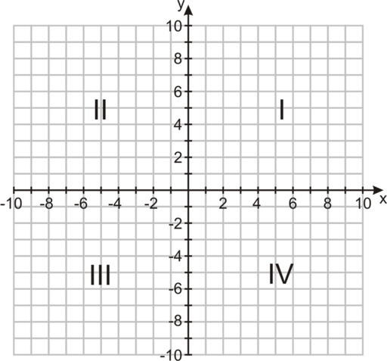
Graphic: Complexity & Priority
Priority
Is this problem threatening my life or the lives of others?
How much am I affected by the persistence of this problem?
The greater the impact, the higher the priority.
Complexity
Does resolving this situation require involving many people?
Will it take a long time to solve it?
Will it take a lot of resources to solve this problem?
The more people, time, and resources, the greater the complexity.

Slide 14
Work environment
For this course we will use the following tools:
1. Cryptographic keychain (blockchain wallet). [Today]
2. Charmverse governance forum. [Today]
3. Snapshot voting ballot box. [Optional]
4. Common multi-signature treasury in SAFE. [Session no. 6]
5. WhatsApp group. [Today]

Slide 15
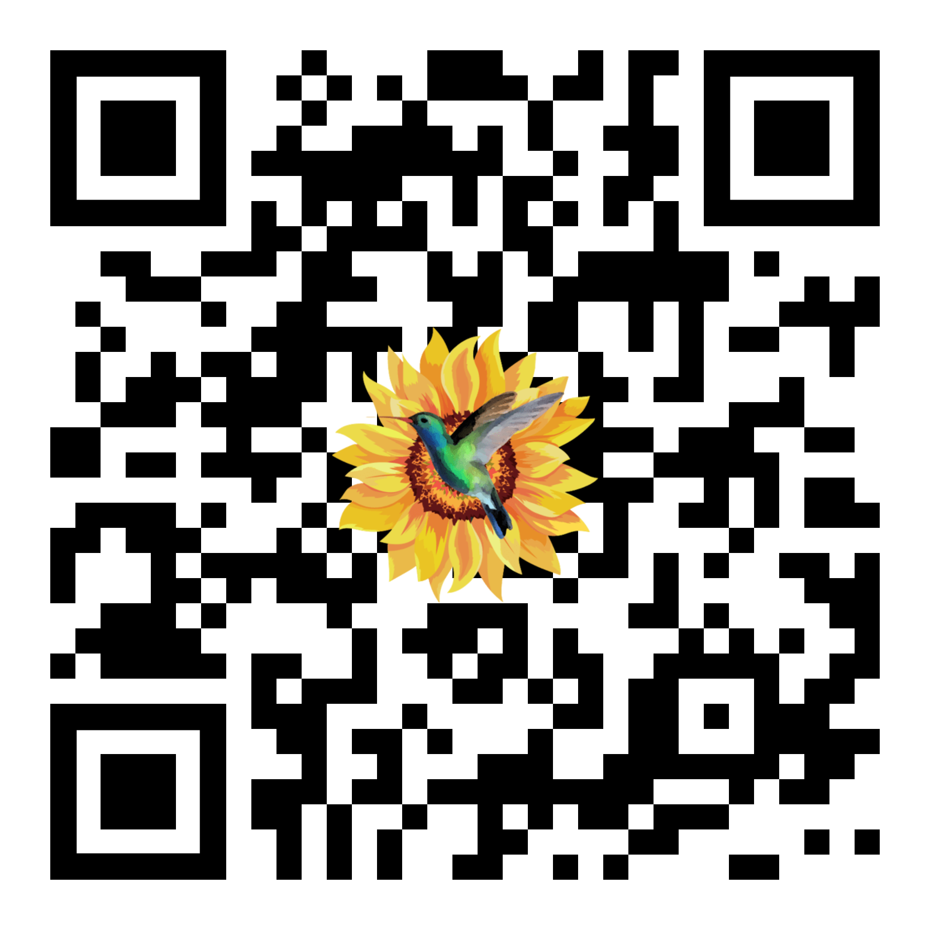
Open a cryptographic key ring (wallet)
https://tally.so/r/w7qb09

Slide 16
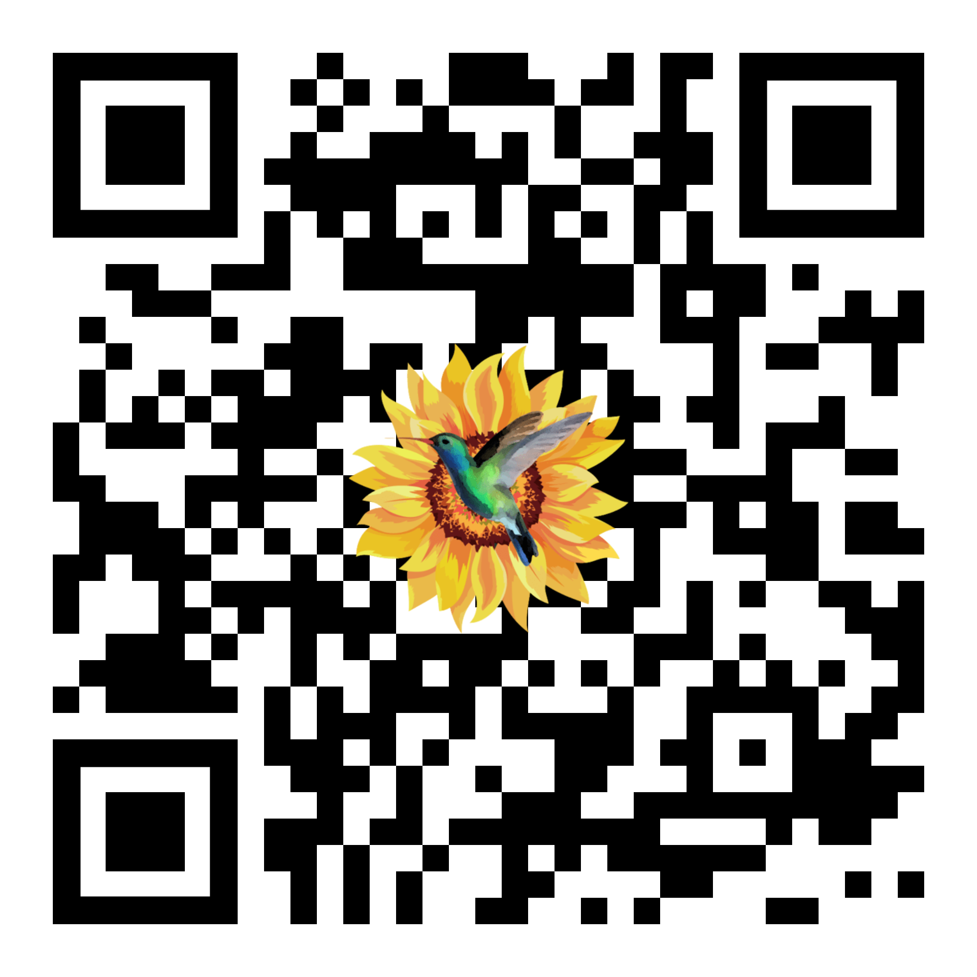
Learn why a crypto key ring is useful
https://tally.so/r/nPD1yd

Slide 17

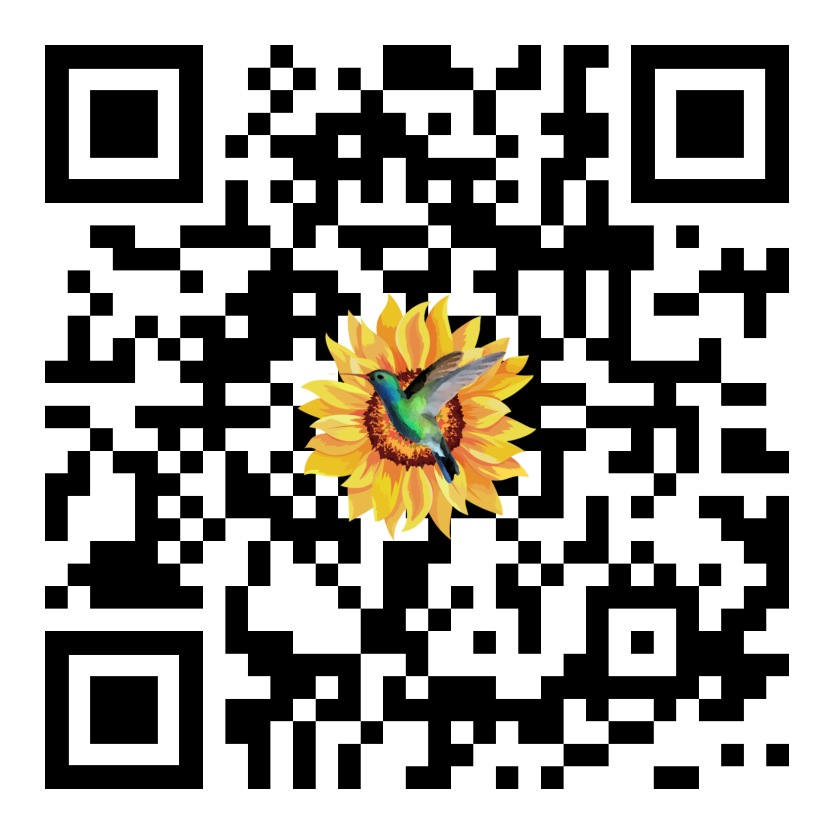
Let’s open a governance forum in
Only one member will open it, the rest will have to enter the forum once it has been created.
Who wants to open it?
It is free (limited use but functional to what we need).
It will be our virtual environment of self-managed participation.

Slide 18
Fin de la primera sesión
Today:
We learned generals of the neighborhood self-management program by Urbánika,
We learned about the common issues of the collective and defined its priority,
We learned about Blockchain technology and wallets,
We created a cryptographic keychain,
We opened the governance forum that we will use as a collective.
Tomorrow:
We will learn about a more efficient and inclusive form of collective decision making than democracy,
We will post one or more ideas in the governance forum,
We will test consent vs. consensus through a dynamic.

Slide 19
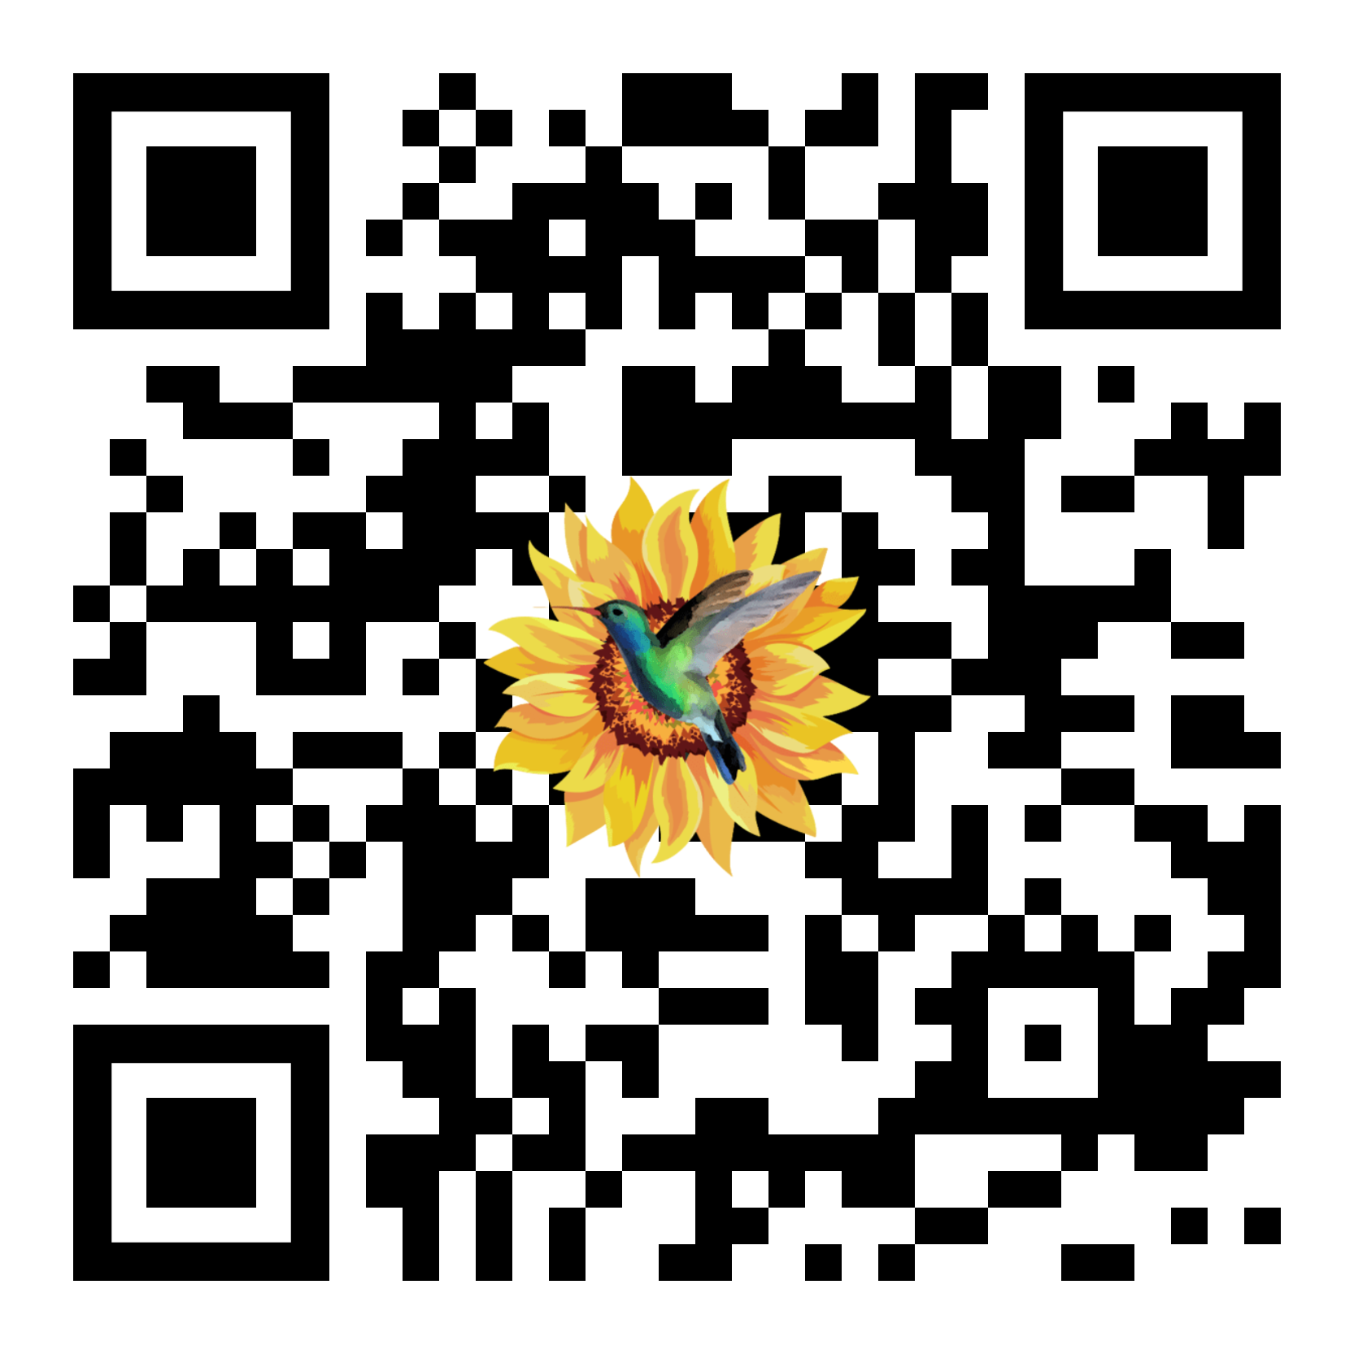
Did you liked Today’s session?
Please, fill this satisfaction survey. It will take you less than a minute.
https://tally.so/r/mKxEoV

Slide 20
Would you like to continue?
Sign the pledge to continue learning and participating in this immersive workshop on neighborhood self-management.
Requirements
Purchase one membership per household:
Membership costs $14 MXN per day x 1 year, or $5,110.00 MXN (~0.78 cents of USD a day or $287 USD a year). Payment can be deferred for 12 weeks which is the duration of the course. If paid in Ether, there is a 10% discount.
The membership includes:
All costs required by the course for blockchain transactions or application usage,
Certificate of graduation on the blockchain,
NFT access for virtual and neighborhood automation applications,
1 year of access to complementary courses and conferences,
1 year of chat support and monthly live support events.
The price of the following year will be decided collectively by all graduated neighbors, and all the excess income will be sent to a multi-signature treasury that active graduated members will co-decide on how to make the best of its use.

